Slide 1

Fast Analytics On Big Data
Case Study
Selecting the Indian Team to
Play Against Rest of World

Slide 2
What You Have to Do?
Task:
You and your team is the BCCI selection committee.
You have to select the Indian team to play against the ‘Rest of World’ team.
The ‘Rest of World’ team has been selected based on historical performance of all the players from test-playing nations.
Historical batting and bowling performance of all players from test playing nations will be provided to you.
You have to select the Indian team based on past performance.
Use statistical methods to analyze past performance
We have ensured that there is a wicket keeper, an all-rounder and a captain for the ‘Rest of World’ team. You have to do the same for the Indian team.

Slide 3

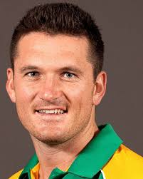
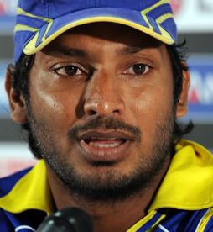
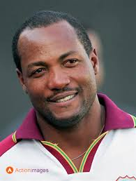
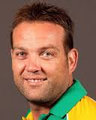
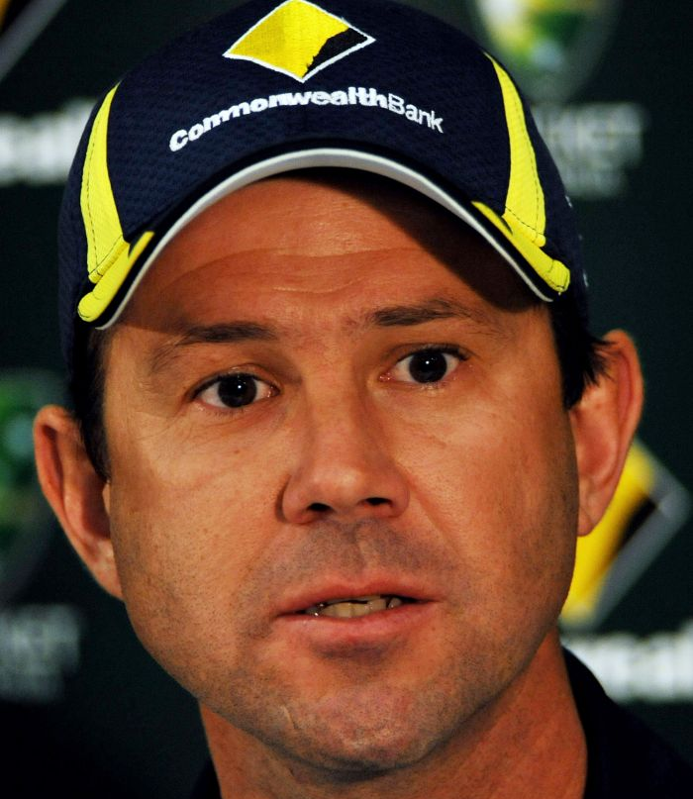

Rest of World Team
Graham Gooch
Greame Smith
K Sangakkara (WK)
Brian Lara
Jacques Kallis
Ricky Ponting (C)
S Chenderpaul

Slide 4
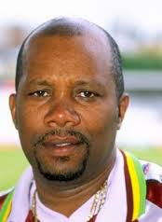
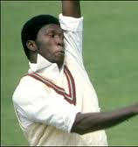
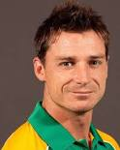
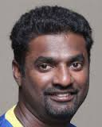
Rest of World Team
Malcolm Marshall
Joel Garner
Dale Steyn
M Muralitharan

Slide 5
Batting Statistics in Test Matches
About the statistics:
Name of player, country and the years that the player has played in test matches
Number of matches played, number of innings batted, number of times the player has been not out
Total runs scored, highest score and if the player was not out in the innings when he scored the highest
Batting average
Number of centuries, half centuries
Number of times the player has been out at zero (duck)

Slide 6
Bowling Statistics in Test Matches
About the statistics:
Name of player, country and the years that the player has played in test matches
Number of matches played, number of innings bowled
Total number of balls bowled, total runs conceded, total wickets taken
Best bowling figures in an innings, best bowling figures in a match
Bowling average, economy rate, strike rate
Number of times the bowler has taken 5 or more wickets in an innings
Number of times the bowler has taken 10 or more wickets in a match

Slide 7
Case Study Presentation
Presentation:
Highlight the Statistical methodology used for selecting the Indian Team.
Explain the methodology in sufficient detail.
Present your selection and explain why this is the best team to take on ‘Rest of World’.
Only use the data provided. Do not use any additional data from other sources.
The presentation should be for about 20 minutes with 10 minutes for Q&A.
All team members should present and interact with us during the Q&A session.

